Slide 1
Introduction to SQL

Slide 2
Types of SQL Statements
Data Definition Language (DDL) Statements
Data Manipulation Language (DML) Statements
Transaction Control Statements
Session Control Statements
System Control Statement
Embedded SQL Statements

Slide 3
Data Definition Language (DDL) Statements
Create, alter, and drop schema objects
Grant and revoke privileges and roles
Analyze information on a table, index, or cluster
Establish auditing options
Add comments to the data dictionary

Slide 4
Data Manipulation Language (DML) Statements
SELECT
UPDATE
DELETE
INSERT
CALL
MERGE (UPSERT – Update OR Insert)

Slide 5
Transaction Control Statements
COMMIT
ROLLBACK
SAVEPOINT
SET TRANSACTION ( Isolation Levels)
SET CONSTRAINT

Slide 6
Oracle Datatypes

Slide 7
Oracle Data Types
Character Datatypes
Numeric Datatypes
DATE Datatype
LOB Datatypes
RAW and LONG RAW Datatypes
ROWID and UROWID Datatypes

Slide 8
Character Datatypes
The character datatypes store character (alphanumeric) data in strings, with byte values corresponding to the character encoding scheme, generally called a character set or code page.

Slide 9
Character Datatypes
CHAR Datatype
VARCHAR2 and VARCHAR Datatypes
Length Semantics for Character Datatypes
NCHAR and NVARCHAR2 Datatypes(Unicode)
Use of Unicode Data in Oracle Database
LOB Character Datatypes
LONG Datatype

Slide 10
CHAR Datatype
The CHAR datatype stores fixed-length character strings.
When you create a table with a CHAR column, you must specify a string length (in bytes or characters) between 1 and 2000 bytes for the CHAR column width.
The default is 1 byte.
If you give a shorter value, then the value is blank-padded to the fixed length.
If a value is too large, Oracle Database returns an error.

Slide 11
VARCHAR2 and VARCHAR Datatypes
The VARCHAR2 datatype stores variable-length character strings.
When you create a table with a VARCHAR2 column, you specify a maximum string length (in bytes or characters) between 1 and 4000 bytes for the VARCHAR2 column.
Using VARCHAR2 and VARCHAR saves on space used by the table.
For example, assume you declare a column VARCHAR2 with a maximum size of 50 characters. In a single-byte character set, if only 10 characters are given for the VARCHAR2 column value in a particular row, the column in the row's row piece stores only the 10 characters (10 bytes), not 50.

Slide 12
VARCHAR Datatype
The VARCHAR datatype is synonymous with the VARCHAR2 datatype.
It is reserved for redefinition in some future version, probably well beyond 11g
To avoid possible changes in behavior, always use the VARCHAR2 datatype to store variable-length character strings.

Slide 13
Length Semantics for Character Datatypes
The length semantics of character datatypes can be measured in bytes or characters.
Byte semantics treat strings as a sequence of bytes. This is the default for character datatypes.
Character semantics treat strings as a sequence of characters. A character is technically a codepoint of the database character set.

Slide 14
NCHAR and NVARCHAR2 Datatypes
NCHAR and NVARCHAR2 are Unicode datatypes that store Unicode character data.
The NCHAR datatype stores fixed-length character strings that correspond to the national character set.
The NVARCHAR2 datatype stores variable length character strings.

Slide 15
NCHAR and NVARCHAR2 Datatypes
The maximum length of an NCHAR column is 2000 bytes. It can hold up to 2000 characters.
The maximum length of an NVARCHAR2 column is 4000 bytes. It can hold up to 4000 characters.

Slide 16
Use of Unicode Data in Oracle Database
Unicode is an effort to have a unified encoding of every character in every language known to man.
A database column that stores Unicode can store text written in any language.
Oracle Database supports a reliable Unicode datatype through NCHAR, NVARCHAR2, and NCLOB.
These datatypes are guaranteed to be Unicode encoding and always use character length semantics.

Slide 17
LOB Character Datatypes
(Large OBject)
The LOB datatypes for character data are CLOB(Character LOB) and NCLOB.
They can store up to 8 terabytes of character data (CLOB) or national character set data (NCLOB).

Slide 18
LONG Datatype
Columns defined as LONG can store variable-length character data containing up to 2 gigabytes of information.
Do not create tables with LONG columns.
Use LOB columns (CLOB, NCLOB) instead.
LONG columns are supported only for backward compatibility.
Oracle also recommends that you convert existing LONG columns to LOB columns.

Slide 19
Overview of Numeric Datatypes
The numeric datatypes store positive and negative fixed and floating-point numbers, zero, infinity, and values that are the undefined result of an operation (that is, is "not a number" or NAN).
NUMBER Datatype
Floating-Point Numbers

Slide 20
NUMBER Datatype
The NUMBER datatype stores fixed and floating-point numbers.
The following numbers can be stored in a NUMBER column:
Positive numbers in the range 1 x 10P-130 to 9.99...9 x 10P125 with up to 38 significant digits
Negative numbers from -1 x 10P-130 to 9.99...99 x 10P125 with up to 38 significant digits
Zero
Positive and negative infinity (generated only by importing from an Oracle Database, Version 5)

Slide 21
Syntax
For numeric columns, you can specify the column as:
column_name NUMBER
Optionally, you can also specify a precision (total number of digits) and scale (number of digits to the right of the decimal point):
column_name NUMBER (precision, scale)
If a precision is not specified, the column stores values as given. If no scale is specified, the scale is zero.
column_name NUMBER (*, scale)
In this case, the precision is 38, and the specified scale is maintained.

Slide 22
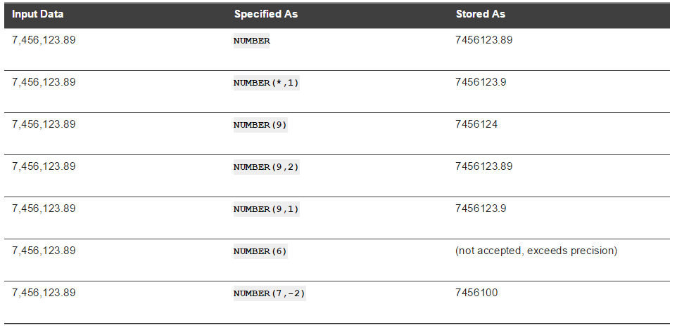
How Scale Factors Affect Numeric Data Storage

Slide 23
Floating-Point Numbers
BINARY_FLOAT
BINARY_DOUBLE.
They support all of the basic functionality provided by the NUMBER datatype.
NUMBER uses decimal precision, BINARY_FLOAT and BINARY_DOUBLE use binary precision.
This enables faster arithmetic calculations and usually reduces storage requirements.

Slide 24
BINARY_FLOAT is a 32-bit, single-precision floating-point number datatype. Each BINARY_FLOAT value requires 5 bytes, including a length byte.
BINARY_DOUBLE is a 64-bit, double-precision floating-point number datatype. Each BINARY_DOUBLE value requires 9 bytes, including a length byte.

Slide 25
Overview of DATE Datatype
The DATE datatype stores point-in-time values (dates and times) in a table.
Date data is stored in fixed-length fields of seven bytes each, corresponding to century, year, month, day, hour, minute, and second.
The standard Oracle date format is DD-MON-YY
Change default format :
TO_DATE ('November 13, 1992', 'MONTH DD, YYYY')

Slide 26
Overview of LOB Datatypes
The LOB datatypes BLOB, CLOB, NCLOB, and BFILE enable you to store and manipulate large blocks of unstructured data (such as text, graphic images, video clips, and sound waveforms) in binary or character format.
Oracle recommends that you always use LOB datatypes over LONG datatypes.
You can perform parallel queries (but not parallel DML or DDL) on LOB columns.

Slide 27
Overview of RAW and LONG RAW Datatypes
The RAW and LONG RAW datatypes are used for data that is not to be interpreted (not converted when moving data between different systems) by Oracle Database.
These datatypes are intended for binary data or byte strings.
For example, LONG RAW can be used to store graphics, sound, documents, or arrays of binary data. The interpretation depends on the use.

Slide 28
LOB Vs LONG/LONG RAW
A table can contain multiple LOB columns but only one LONG column.
A table containing one or more LOB columns can be partitioned, but a table containing a LONG column cannot be partitioned.
The maximum size of a LOB is 128 terabytes depending on database block size, and the maximum size of a LONG is only 2 gigabytes.
LOBs support random access to data, but LONGs support only sequential access.
Tables with LOB columns can be replicated, but tables with LONG columns cannot.

Slide 29
Overview of ROWID and UROWID Datatypes
Oracle Database uses a ROWID datatype to store the address (rowid) of every row in the database.
Physical rowids store the addresses of rows in ordinary tables
Logical rowids store the addresses of rows in index-organized tables.

Slide 30
Universal rowid (UROWID)
supports both logical and physical rowids, as well as rowids of foreign tables such as non-Oracle tables accessed through a gateway.

